Slide 1
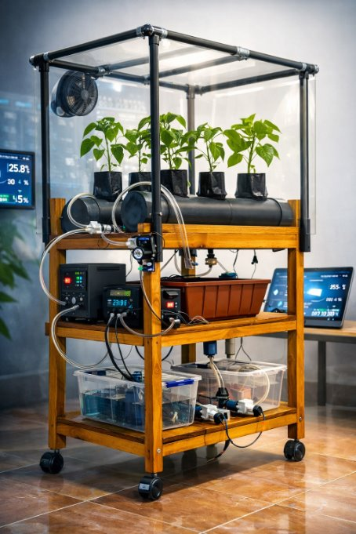
IT4010 – Progress Presentation 2
25-26J-035
An Energy-Efficient Dual Hydroponic System for Organic/Inorganic Capsicum Chili Farming

Slide 2
PROBLEM STATEMENT & STAKEHOLDERS

Slide 3
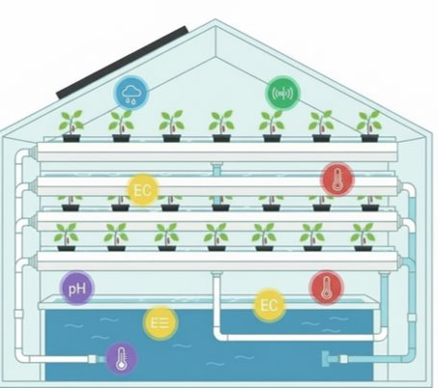
PROBLEM STATEMENT & STAKEHOLDERS
Context
Hydroponic capsicum chili farming in Sri Lanka requires efficient monitoring and automation, especially in solar-powered or resource-limited greenhouse environments.
Why It Matters
These limitations lead to higher energy usage, increased disease risk, reduced crop productivity, and slow adoption of smart hydroponic farming.
Stakeholders
Primary users: Hydroponic farmers, greenhouse operators
Secondary users: Agricultural researchers, smart farming developers
Decision makers: Agricultural authorities, agritech companies, investors
Observed Issue
Existing hydroponic systems are fragmented and energy-intensive, lacking integrated communication, adaptive climate control, and early disease prediction.

Slide 4
RESEARCH GAP & OBJECTIVES

Slide 5
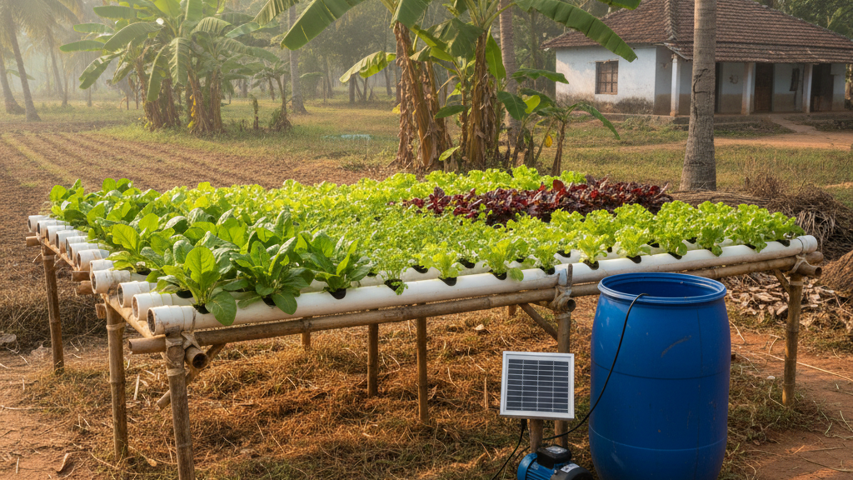
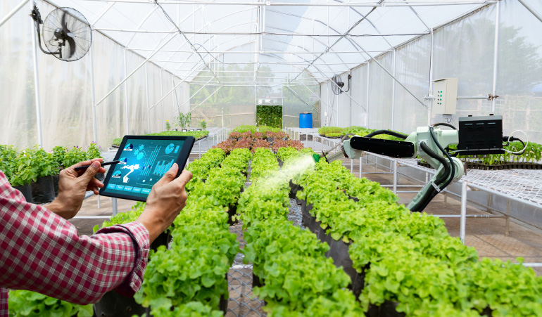
RESEARCH GAP & OBJECTIVES
Research Gap
Existing hydroponic systems focus only on basic monitoring
Lack energy-efficient communication for IoT systems
Limited adaptive climate control using real-time data
No early disease prediction mechanisms
Poor integration of organic and inorganic hydroponic systems
Smart Objectives
Design an IoT-enabled dual NFT hydroponic system
Integrate smart climate control using sensor data and weather data
Implement energy-efficient communication and cloud monitoring
Enable early fungal disease prediction for healthy capsicum growth

Slide 6
SOLUTION OVERVIEW

Slide 7
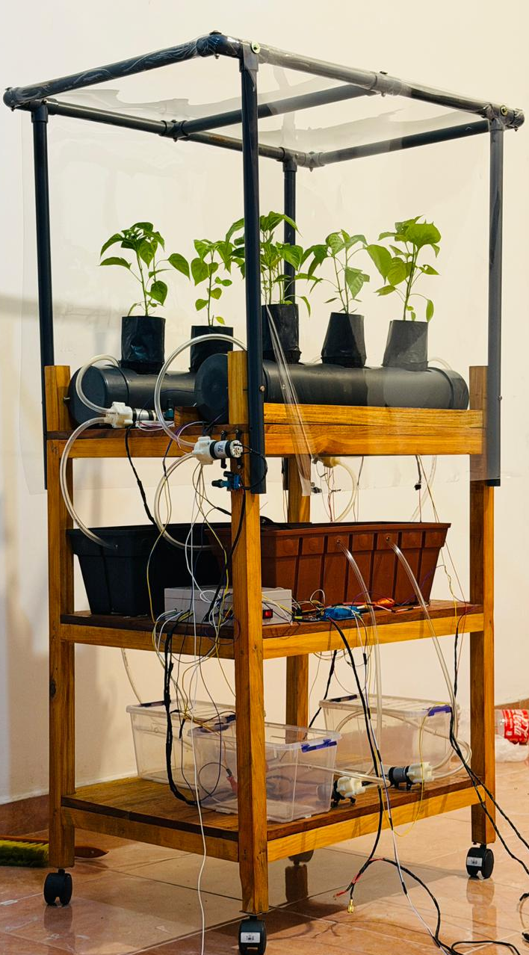
SOLUTION OVERVIEW
Solution Summary: An IoT-enabled energy-efficient dual NFT hydroponic system for capsicum cultivation with smart climate control and cloud monitoring.
Key Features Delivered:
FR1: Real-time sensor monitoring (pH, EC, temperature, humidity, water level)
FR2: Automated climate control (fan, mist, ventilation)
FR3: Low-power UDP communication with cloud dashboard
Non-Functional Focus:
Performance: Efficient sensor data processing and automation
Reliability: Continuous monitoring with communication backup
Usability: Cloud dashboard for real-time monitoring and control
Current Completion Status: ~90% system implementation completed and ready for demonstration.

Slide 8
SYSTEM ARCHITECTURE & INTEGRATION

Slide 9
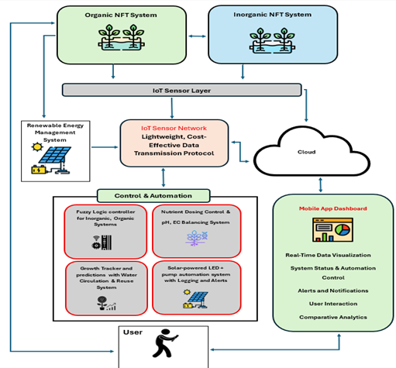
SYSTEM ARCHITECTURE & INTEGRATION
Label Owners
Component A:
Organic NFT Hydroponic System - IT22167682​
Component B:
Inorganic NFT Hydroponic System - IT22258762​
Component C:
IoT Communication System - IT22355782​
Component D:
Automated Climate Control & Disease Prediction - IT22617996​

Slide 10
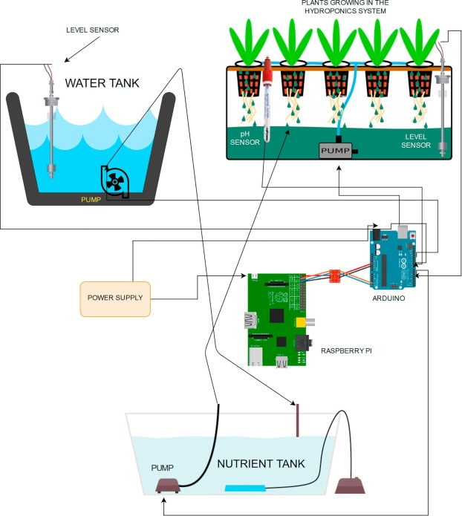
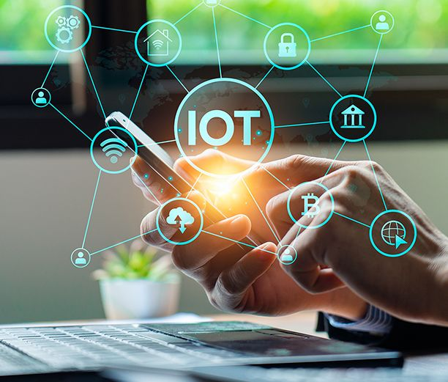
SYSTEM ARCHITECTURE & INTEGRATION
Integration Points
UDP protocol for sensor communication
Firebase API for cloud data storage
Weather API for external weather data
JSON data format for sending sensor data
Deployment / Runtime Setup
Edge devices: ESP32 in greenhouse
Cloud: Firebase database
Backend: Python Flask server
User interface: Mobile dashboard

Slide 11
COMMERCIALIZATION

Slide 12

COMMERCIALIZATION
Target Users / Market: Hydroponic farmers, greenhouse operators, and smart agriculture researchers.
Adoption Plan / Next Steps: Pilot testing in greenhouse environments, followed by scaling and deployment for commercial hydroponic farming.
Value Proposition: Provides automated monitoring, energy-efficient operation, and early disease prediction, improving crop productivity compared to traditional hydroponic systems.
Cost and Feasibility: Prototype cost approximately LKR 55,000 – 65,000, feasible using affordable IoT components.

Slide 13
DEMONSTRATION PLAN

Slide 14

DEMONSTRATION PLAN
Demo Flow
Step 1: Show real-time sensor monitoring for Organic and Inorganic NFT systems. Step 2: Demonstrate low-power UDP network communication . Step 3: Show AI leaf disease detection and automated climate control using weather and sensor data.
Team Demo Roles
Member 1: Inorganic hydroponic system monitoring. Member 2: Low-power adaptive network & data transmission. Member 3: Organic hydroponic system & compost monitoring. Member 4: Climate control, disease prediction & AI leaf detection.
Key Features
Organic and Inorganic systems
Low-power IoT communication
AI disease detection & automated climate control

Slide 15
THANK YOU

